Slide 1
Linear Mixed Model Analysis

Slide 2
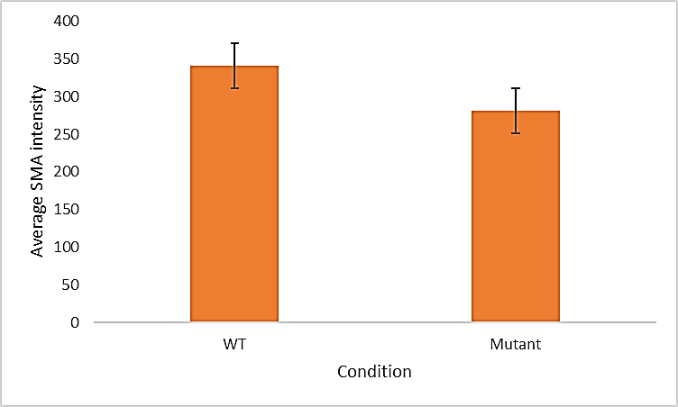
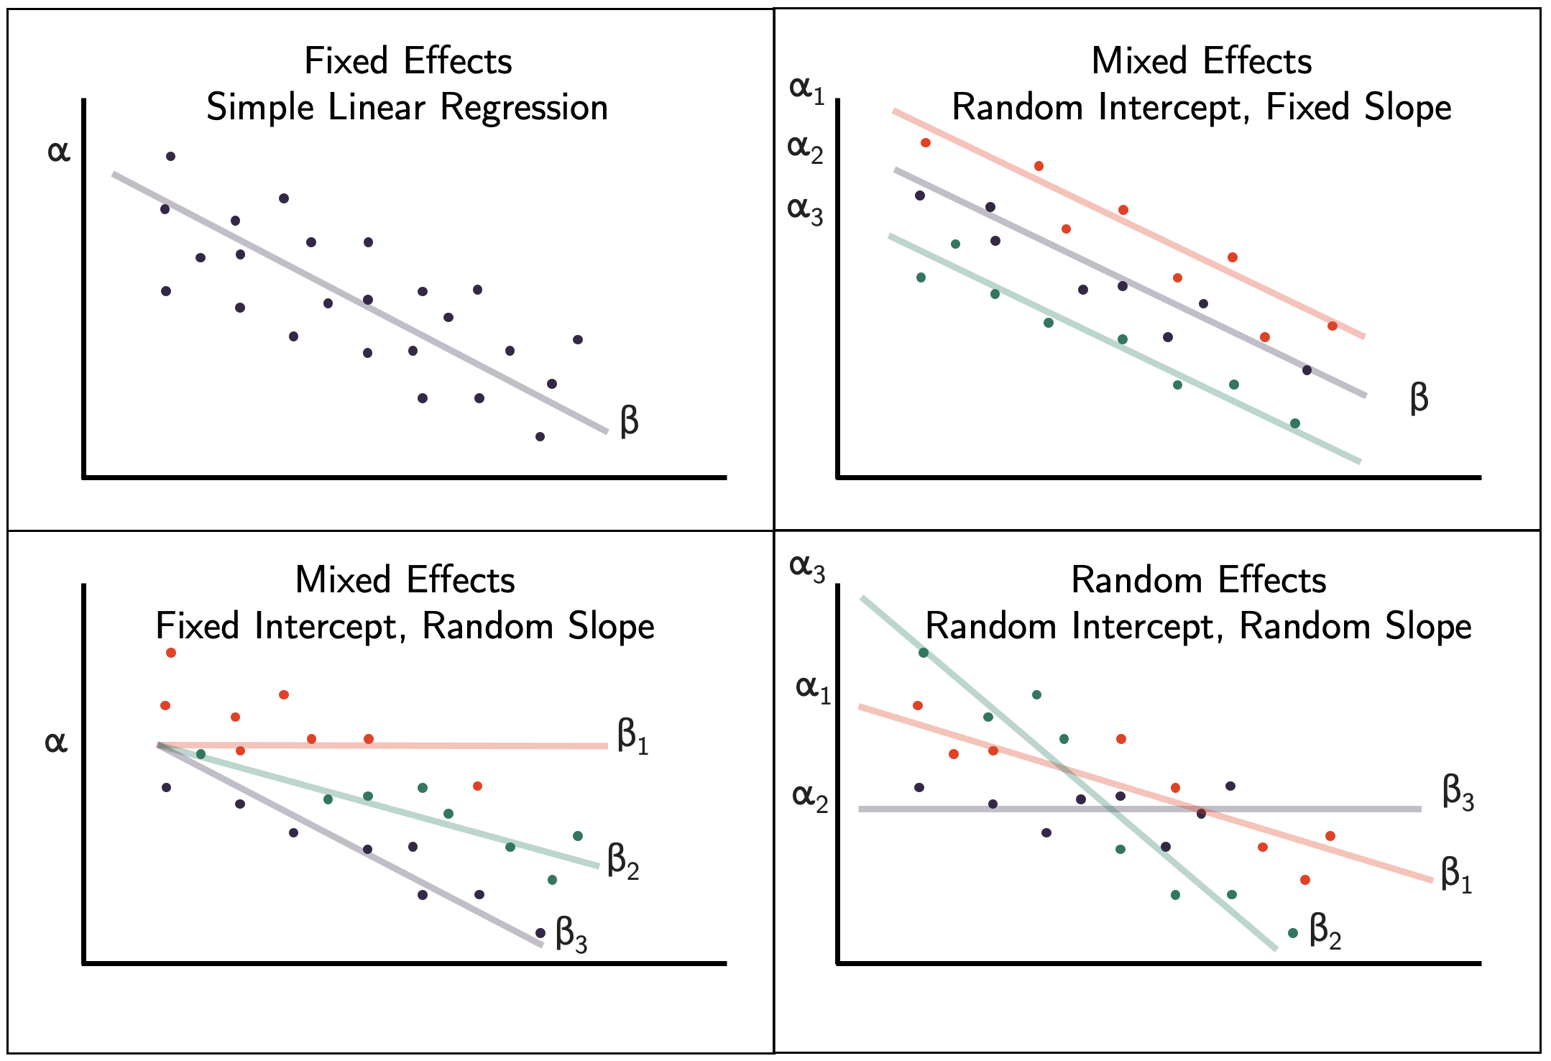
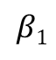
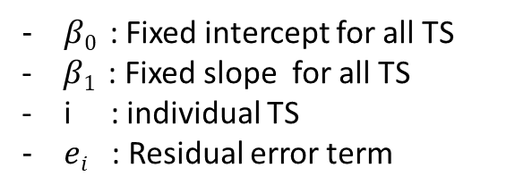



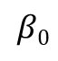
Are the mean SMA intensities different between WT & Mutant conditions?
Experimental Design
Effect of Condition on Avg. SMA Intensity
Fixed effect
(Effect of interest)
Condition
WT
Mutant
Mutant
Mutant
Animal
Number
1
2
11
1
2
11
1
2
11
…
1
2
…
11
…
…
Transitional
Segment
1
…
n
1
…
n
1
…
n
1
n
1
n
1
n
1
n
1
n
1
n
1
n
1
n
1
…
n
…
…
Linear Model
$$β0$$
$$Intensityi= β0+ β1 Conditioni+ei$$
Average SMA Intensity
$$β1$$
$β0$ : Fixed intercept for all TS
- $β1$ : Fixed slope for all TS
i : individual TS
$ei$ : Residual error term
WT
Mutant

Slide 3

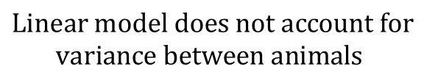
Does WT/Mutant condition affect the Mean SMA Intensity?
Experimental Design
Effect of Condition on Avg. SMA Intensity
Fixed effect
(Effect of interest)
Condition
WT
Mutant
Animal
Number
1
2
…
11
1
2
11
Random Effect
…
Transitional
Segment
1
…
n
1
…
n
1
…
n
1
…
n
1
…
n
1
…
n
$$Linear model does not account for$$
$$variance between animals$$
$$Random Effect$$

Slide 4
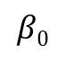
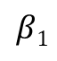
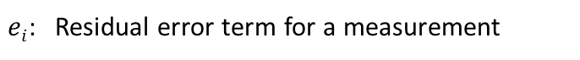
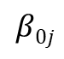
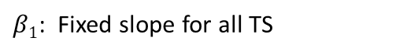
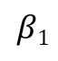
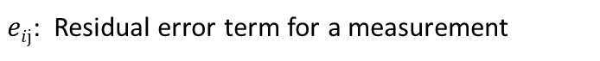
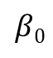
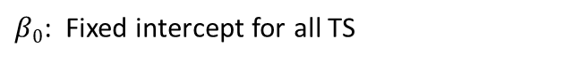
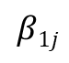
Linear Model
Linear Mixed Effects Model
$$Intensityi= β0+ β1 Conditioni+ei$$
$$Intensityij= β0j+ β1j Conditionij+eij$$
$$i: Individual measurement$$
$$ij:Individual TS measurement from animal j$$
$β0$: Fixed intercept for all TS
$β0j$: Fixed intercept + Deviation of animal j’s intercept
$β1$: Fixed slope for all TS
$β1j$: Fixed slope + Deviation of animal j’s slope
$ei$: Residual error term for a measurement
$eij$: Residual error term for a measurement
$$β0$$
Animal j
$$β0$$
$$β1$$
Average SMA Intensity
Average SMA Intensity
$$β0j$$
$$β1$$
$$β1j$$
WT
Mutant
WT
Mutant
Deviation of intercept

Slide 5







Linear Mixed Effect Model: Types
(Depending on the slopes and intercepts at the “Animals” level)
Regression Lines
Animal 1
Animal 2
Animal 3
Baseline of each animal: Varies
Effect of Condition: Fixed
Baseline of each animal: Varies
Effect of Condition: Varies
Baseline of each animal: Fixed
Effect of Condition: Varies

Slide 6
Building a Linear Mixed Effects Model
1. Build a null or Random Effects model
Find Intra-animal correlation
2. Build a random intercepts & fixed slopes model with predictor
Compare explained variance to the base model
3. Build a random intercepts & random slopes model with predictor
Check whether slope variation between animals is significant.
R packages
lme4, lmerTest
4. Decide the final model

Slide 7
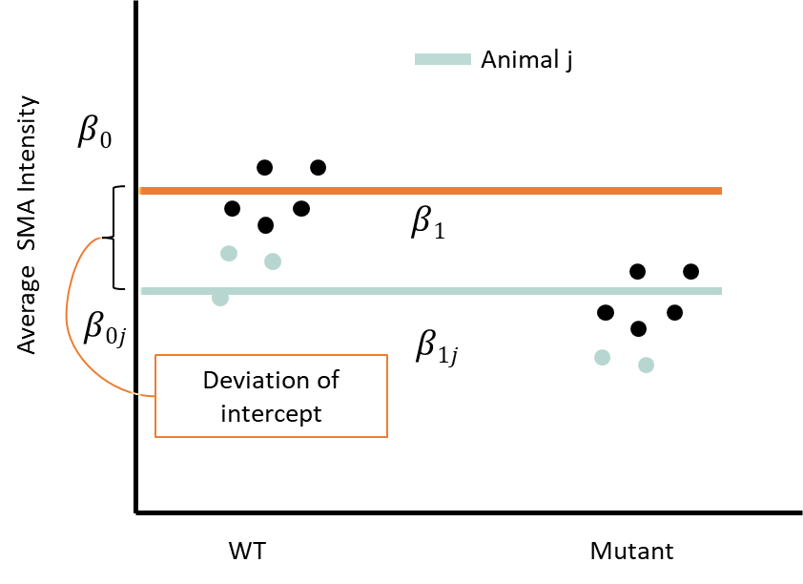
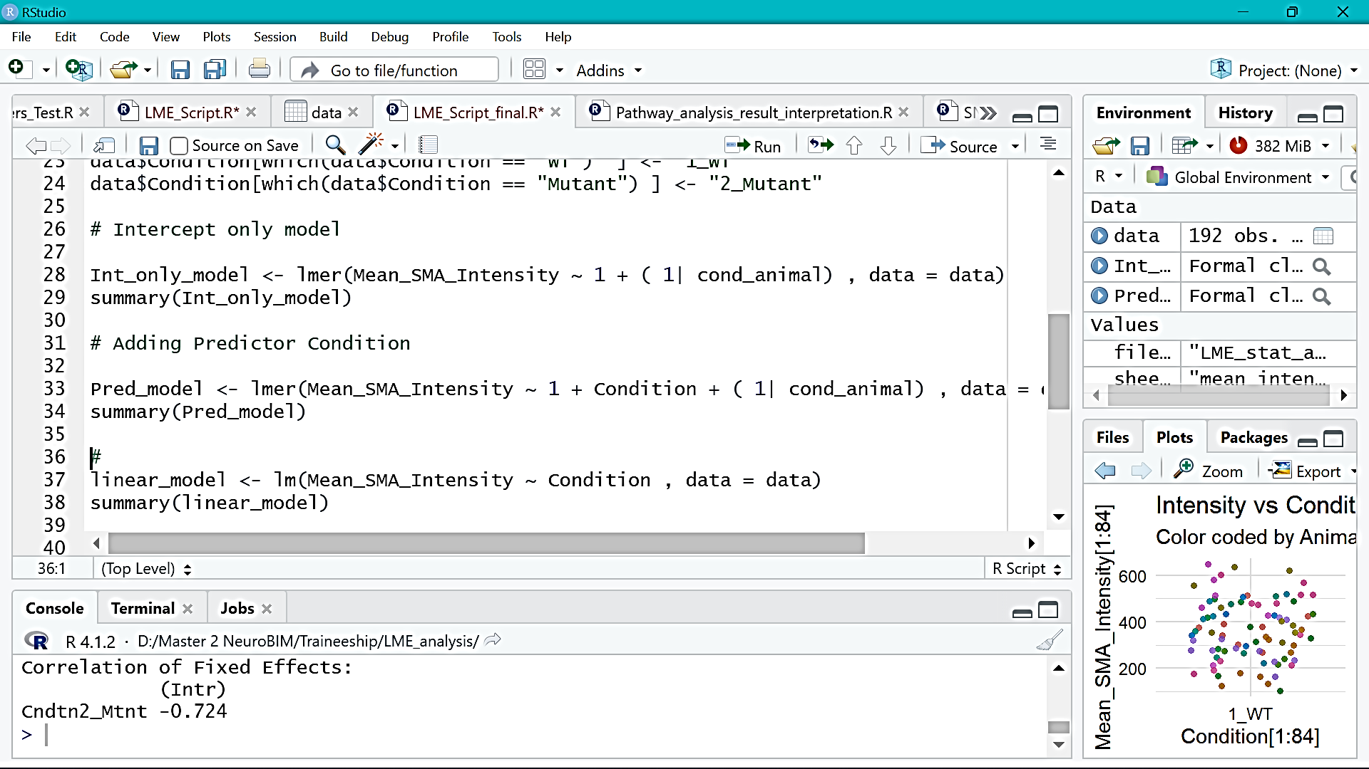

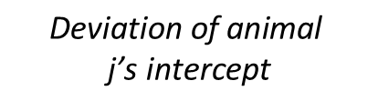
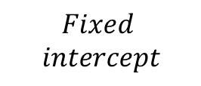
1. Building a null or Random Effects model
Predictor (WT/Mutant) information
is not included.
Equation
Formula in R
$$Intensityij= β0j+eij$$
$β0j$ = Fixed intercept +
Deviation of animal j’s intercept
$$Fixed$$
$$intercept$$
$$\text{Deviation} \text{of} \text{animal}$$
$$\text{j}\text{’}\text{s} \text{intercept}$$

Slide 8
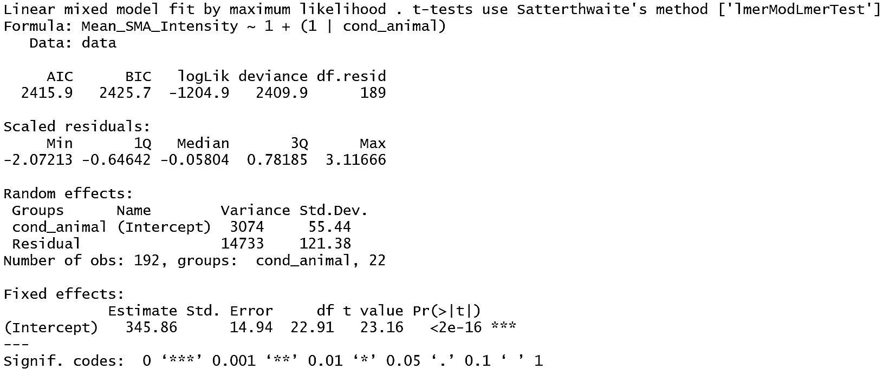
Tests equality of means.
Assumptions: unequal variances ; unequal sample sizes
Find Intra Class Correlation (ICC)
Summary
ICC =
Variance (cond_animal)
(Variance(cond_animal) + Variance (Residual))
3074
0.17
=
=
3074+14733
The total variance explained by the grouping structure (Animals) is 0.17 (17%).
Interpretation
or
The correlation between two measurements from the same group is 0.17.

Slide 9
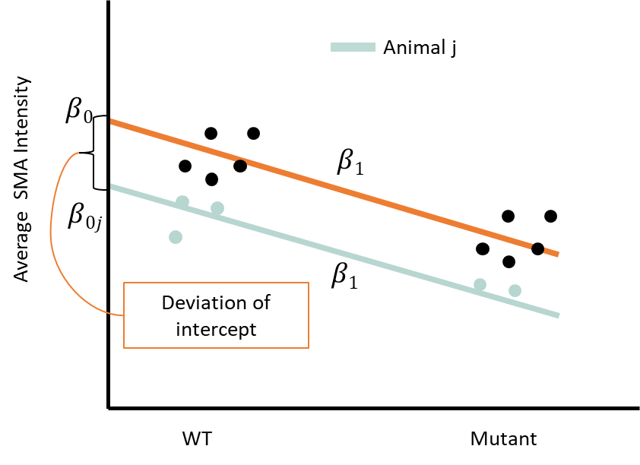
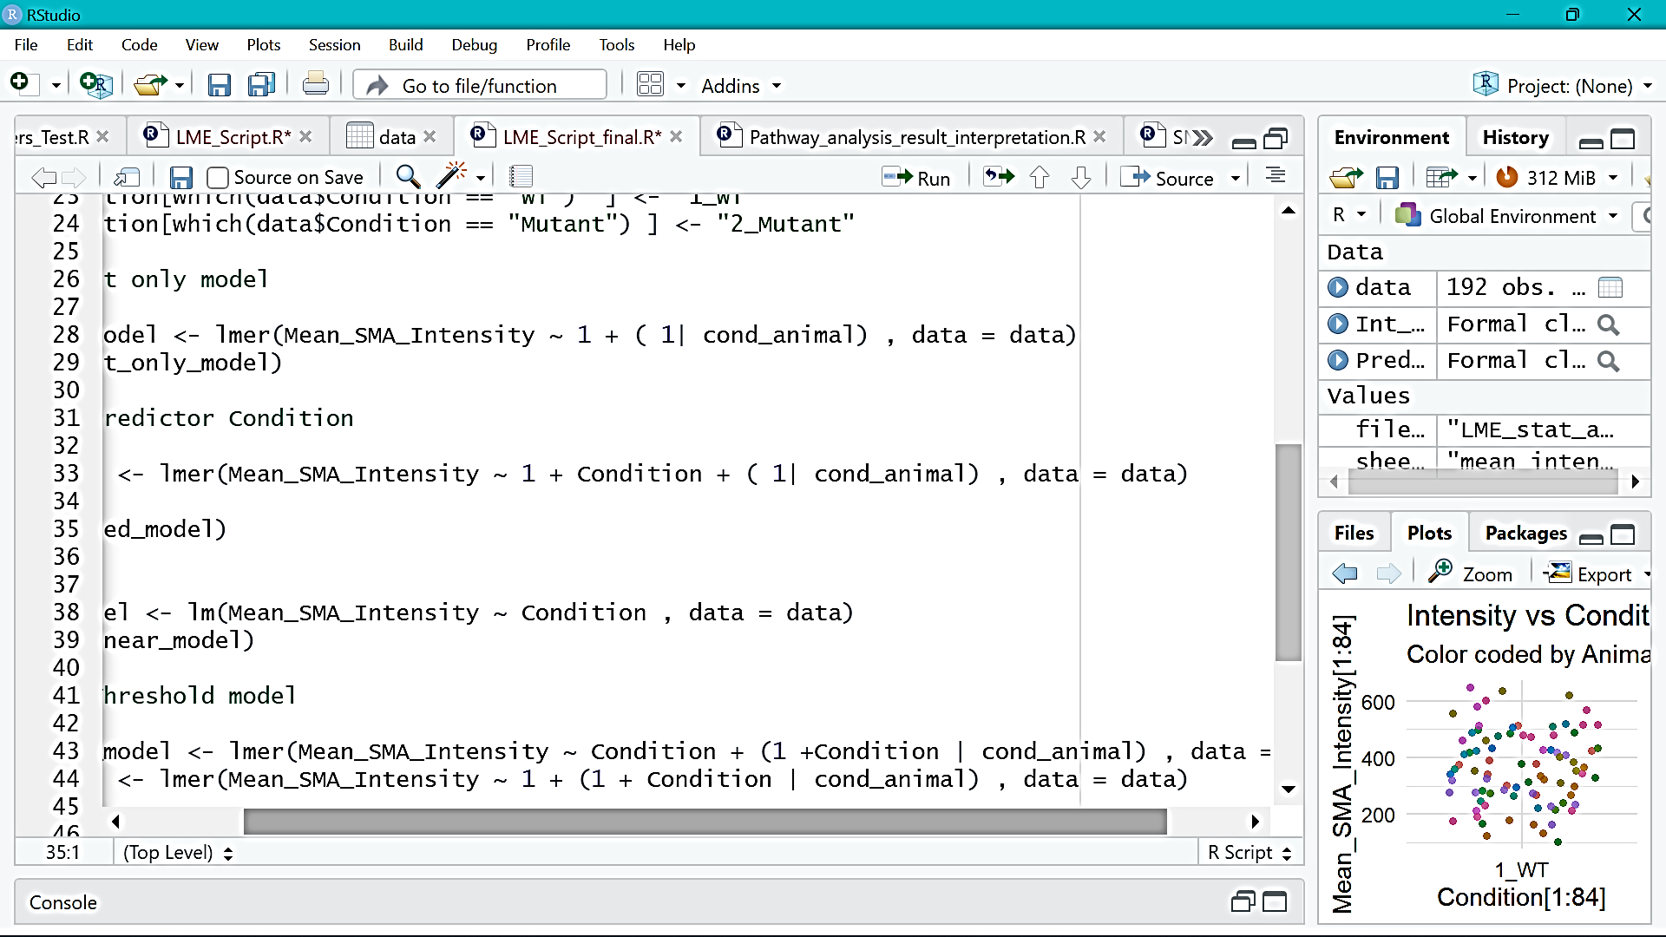

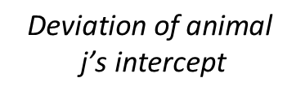
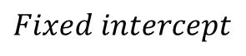


2. Building a Random Intercept model with Predictor
Variation in the Predictor’s effect at
individual animal level is excluded.
Formula in R
Equation
$$Intensityij= β0j+ β1 Conditionij+eij$$
$$Fixed intercept$$
$$Predictor$$
$$\text{Deviation} \text{of} \text{animal}$$
$$\text{j}\text{’}\text{s} \text{intercept}$$
$β0j$ = Fixed intercept +
Deviation of animal j’s intercept
$βij$ = Fixed slope

Slide 10
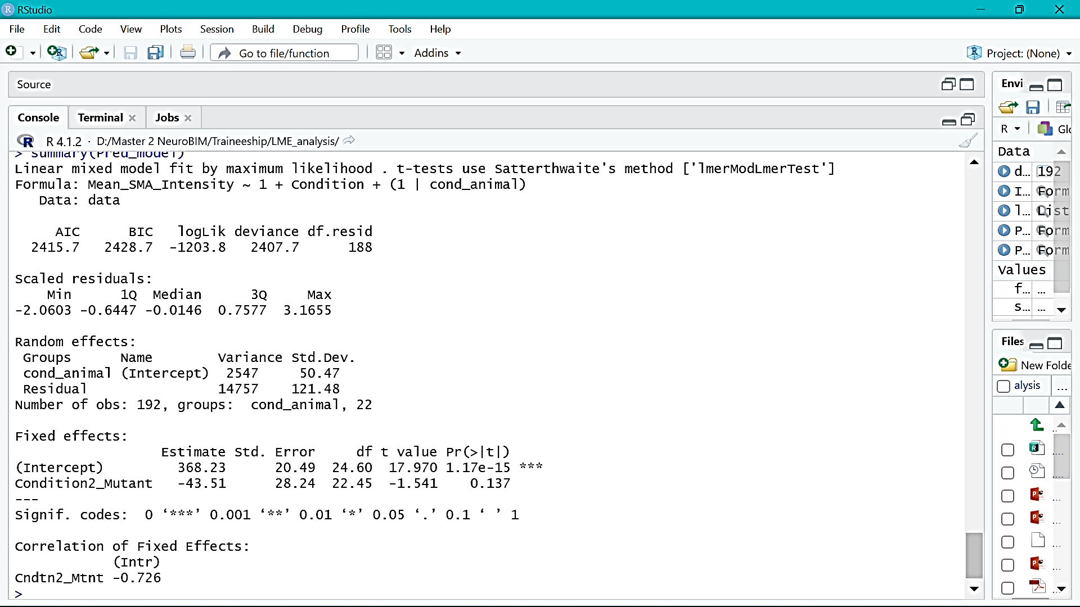
2. Building a Random Intercept model with Predictor
Summary
Variance in the animal baselines from the intercept: 2547
Reference level: WT
The regression co-efficient for Mutant compared to WT is -43.51.
The mutant mean intensity is 43.51 units less than WT.
p-value of fixed effect estimate : 0.137
The regression co-efficient for Condition is not significantly different from 0.

Slide 11
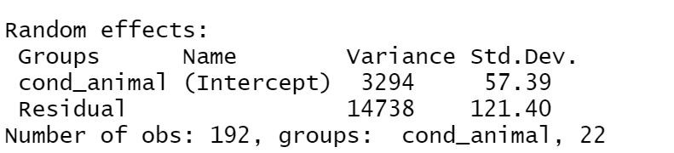
Compare explained variance with null model
Calculate explained variance at Level 1 ( between TS) and Level 2 (between Animals)
Null model
Random Intercept model with Predictor
Explained Variance
Level 1
(Residual)
14738 - 14757
=
=
-0.0012
14738
Level 2 (Cond_animal)
3294 - 2547
=
=
0.22
3294

Slide 12
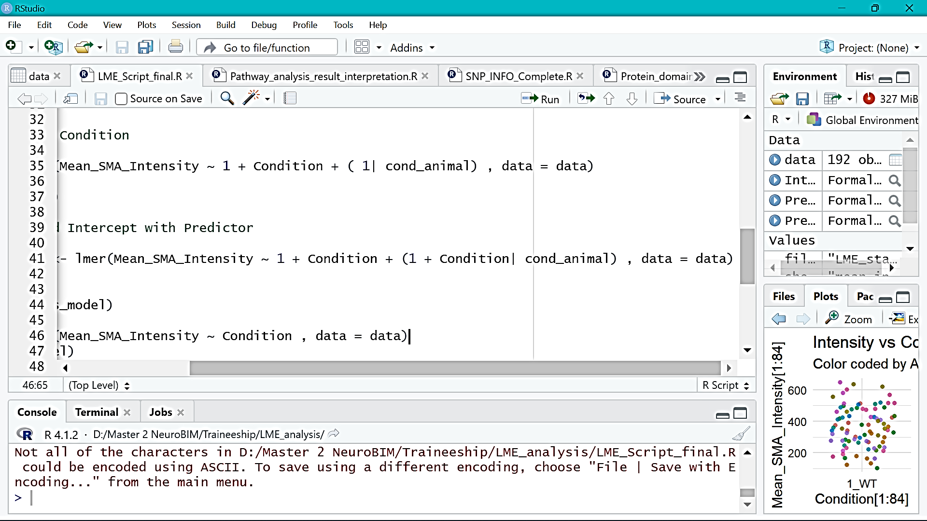
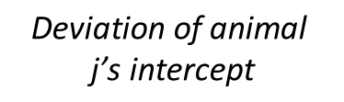
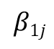
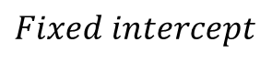
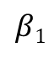

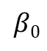
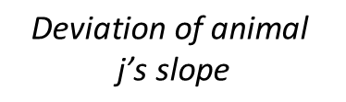
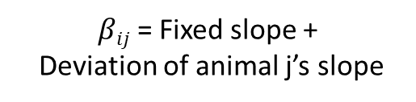

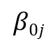
3. Random Intercepts & Slopes model with Predictor
Animal j
$$β0$$
Baseline difference and Effect of Predictor on
Intensity between animals is also considered.
$$β1$$
Average SMA Intensity
$$β0j$$
$$β1j$$
Deviation of intercept
WT
Mutant
Equation
Formula in R
$β0j$ = Fixed intercept +
Deviation of animal j’s intercept
$$Fixed intercept$$
$$\text{Deviation} \text{of} \text{animal}$$
$$\text{j}\text{’}\text{s} \text{intercept}$$
$$Predictor$$
$$\text{Deviation} \text{of} \text{animal}$$
$$\text{j}\text{’}\text{s} \text{slope}$$
$βij$ = Fixed slope +
Deviation of animal j’s slope

Slide 13
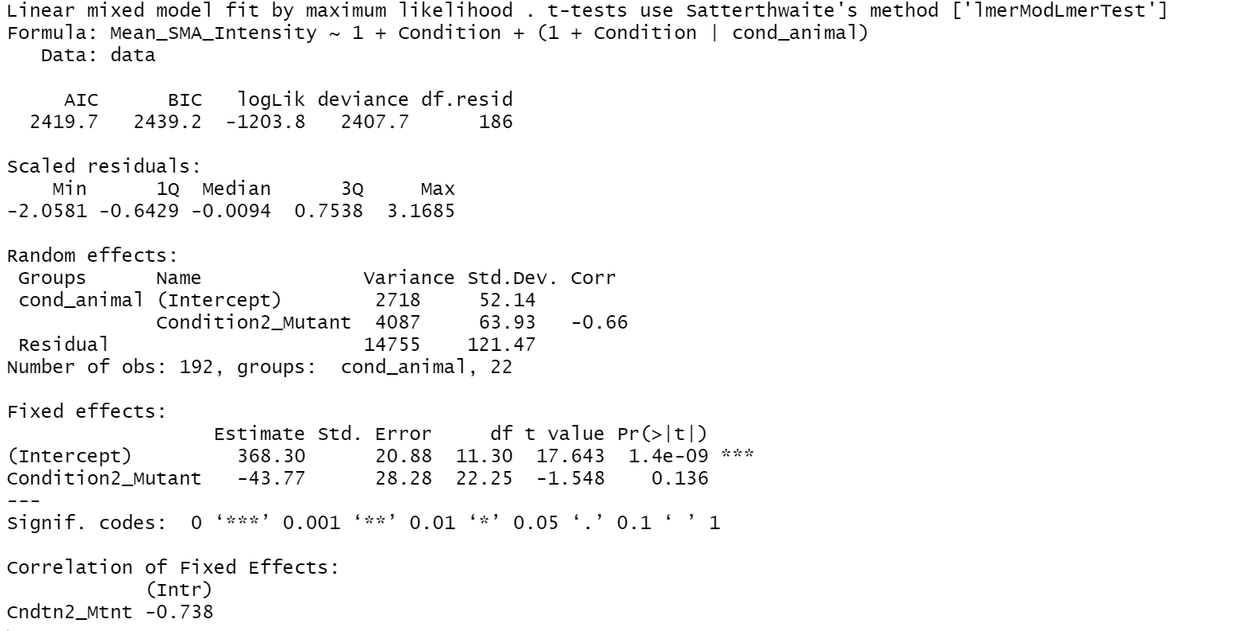
3. Random Intercepts & Slopes model with Predictor
Summary
Variance in animal slopes from the fixed slope: 4087 (High)
The regression co-efficient for Mutant compared to WT: -43.77.
The mean intensity in mutant is 43.77 units less than WT.
p-value for fixed effect estimate : 0.136
The regression co-efficient is not significantly different from 0.

Slide 14
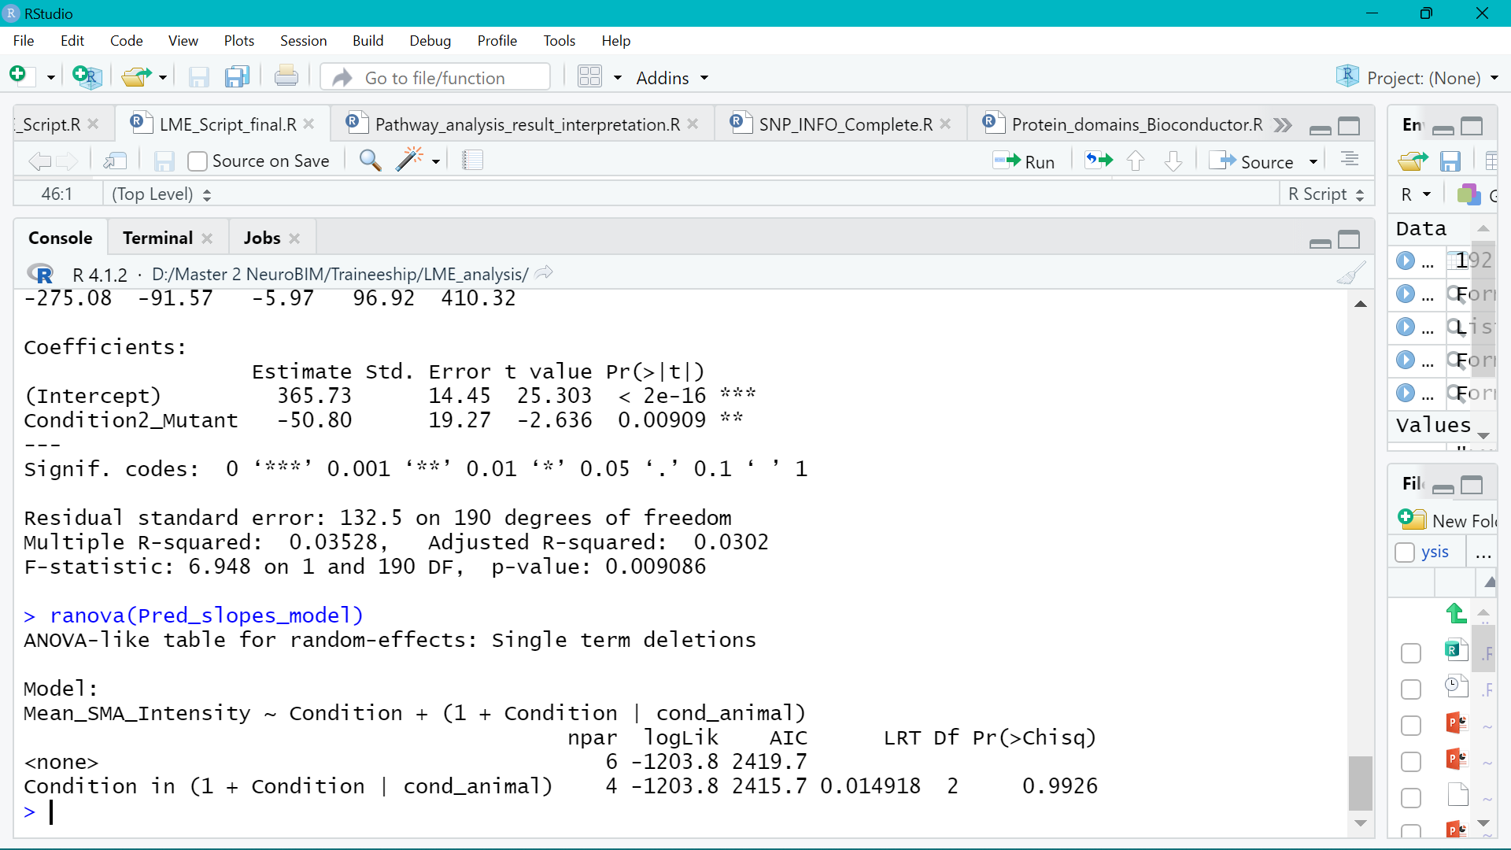
Check significance of slope variance between animals
Does adding Random slopes in the model make it better?
Interpretation:
The variation in the random effect of condition between animals is not significant.

Slide 15
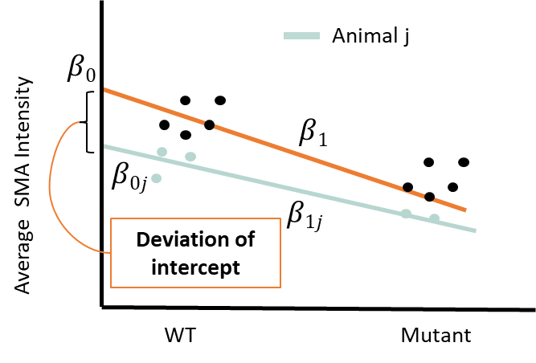
4. Choose the best model
Dependent Variable | Model name | Effect Estimate (Ref: WT) | SE | p-value | P-value for Condition in Random Effect | AIC
Mean SMA Intensity | Random Intercept | -43.51 | 28.24 | 0.137 |  | 2415.7
Mean SMA Intensity | Random Intercept and Slope | -43.77 | 28.28 | 0.136 | 0.9926 | 2419.7
Akaike's information criterion (AIC) : Lower value for better models
Complex Random intercepts & Random slopes model does not give a better fit.
Complex intercept model is not a better fit than the null model.

Slide 16
4. Choose the best model
Steps 1-3 were repeated for the Mef2c intensity values
Dependent Variable | Model name | Effect Estimate | SE | p-value | P-value for Condition in Random Effect | AIC
Mef2c_cell_10000_µm2 | Random Intercept | -2.4167 | 1.3603 | 0.0892 |  | 1283
Mef2c_cell_10000_µm2 | Random Intercept and Slope | -2.3947 | 1.3422 | 0.0899 | 0.4636 | 1285.4
Complex Random intercepts & Random slopes model does not give a better fit.
Complex intercept model is not a better fit than the null model.

Slide 17
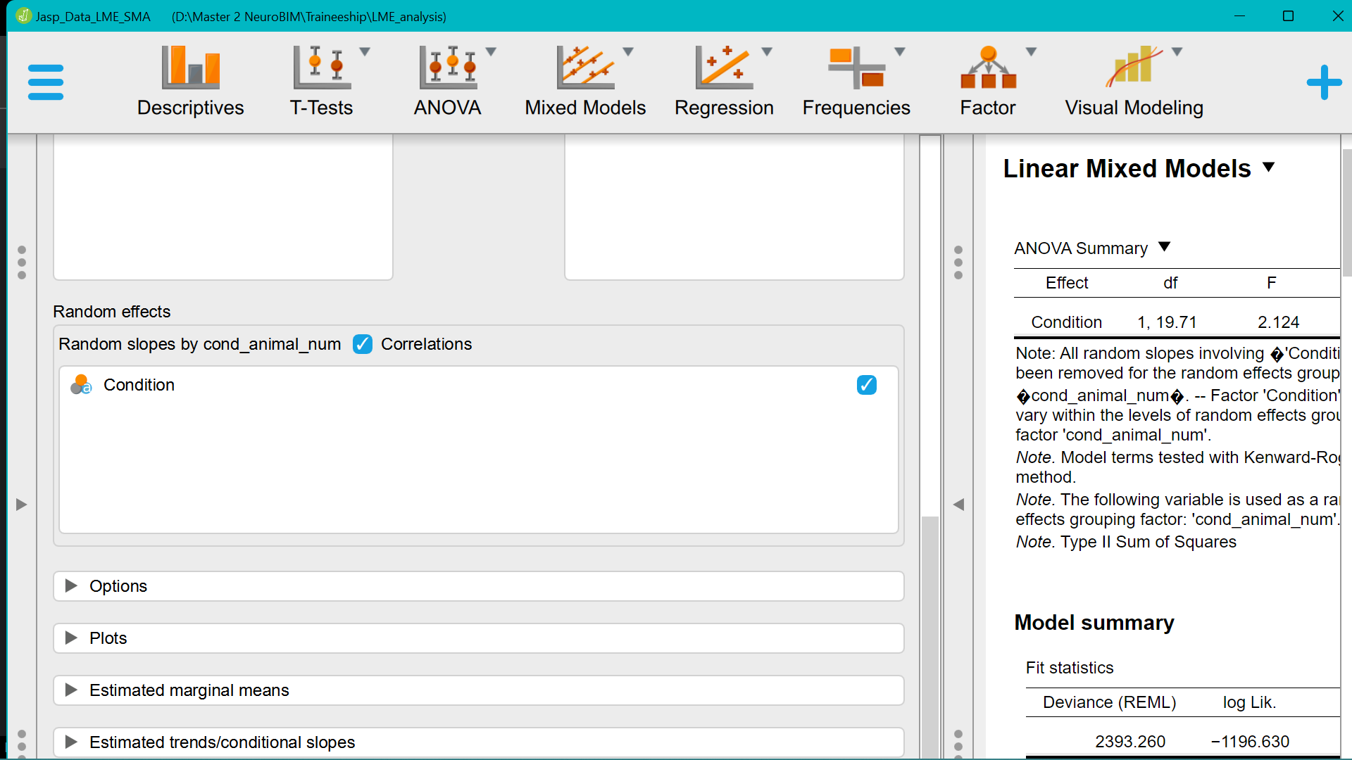
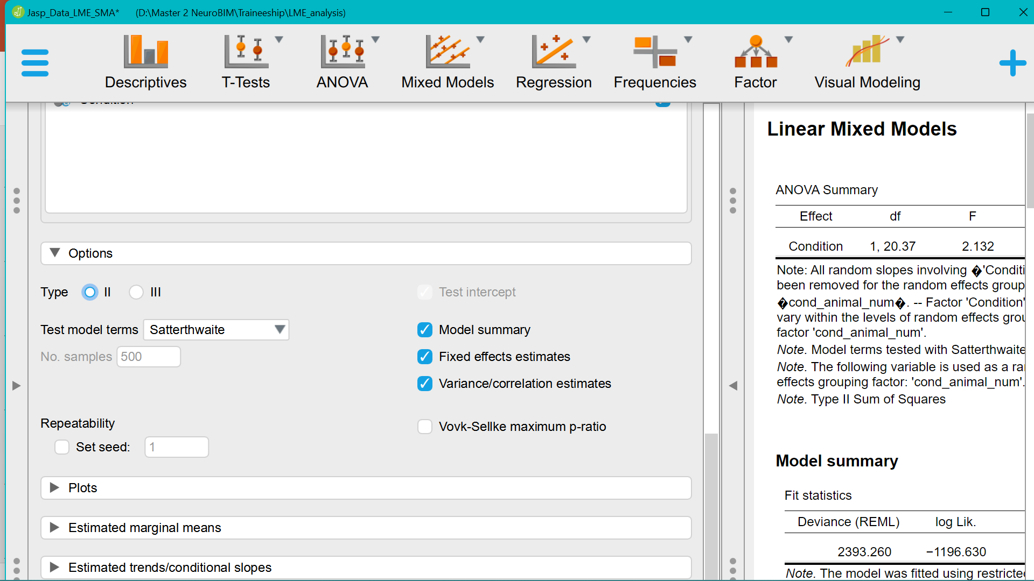
LME model settings in JASP
Choose correlations for Random slopes and Random Intercepts model
ANOVA Types:
II : Models without interaction
III: Models with Interaction

Slide 18
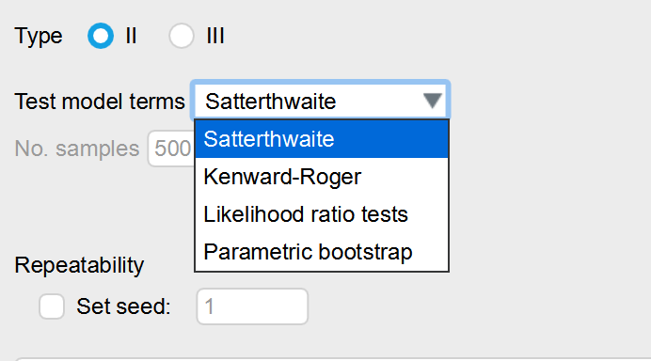
LME model settings in JASP
Test Method | Properties
Satterthwaite | ML or REML models ; Unequal variances between two populations; Small sample size (< 50)
Kenward Roger | REML model fitting; Small sample size (< 50)
Likelihood Ratio test (LRT) | Large sample size (> 50); ML model fitting
Parametric bootstrap | No assumptions about DoF; Repeated sampling to obtain p-values from LRT; Computationally intensive but works for all sample sizes
Model Fitting method | Properties
Maximum Likelihood | Biased Variance estimates; Can be used to compare two models
Restricted Maximum Likelihood | Unbiased Variance estimates; Cannot compare two models

Slide 19
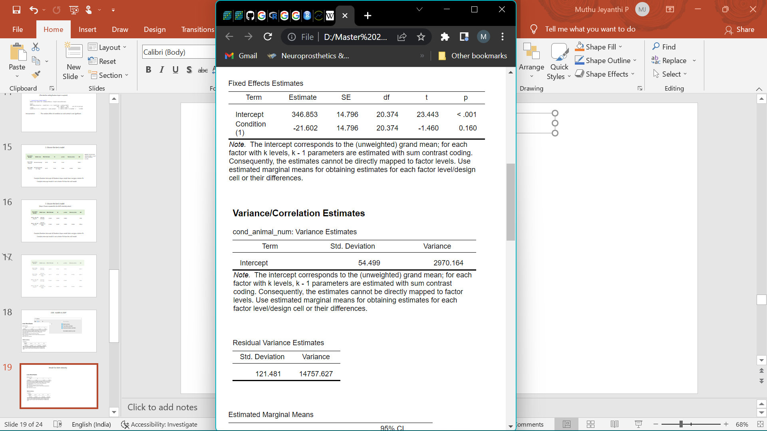
Result for SMA Intensity (Random Intercepts and Slopes model)
LME4
JASP
Dummy coding: WT: 0 Mutant: 1
Sum contrast coding: WT : – 1 Mutant: 1 No effect: 0
Equation of the final LME fit
$$Intensity= β0+ β1 Condition+e$$
Intercept: Mean of the WT condition
Condition2_Mutant: Difference of mean intensity of mutant from WT condition → Mutant level effect
Mutant mean : 368.23 + (-43.51) (+1) = 324.72
Intercept: Grand mean across all values
Condition(1) Estimate: The difference of condition from grand mean → Main effect of condition
Mutant mean : 346.853 +(-21.602) (+1)= 325.351
WT mean : 346.853 + (-21.602) (-1) = 368.455
Notes:
Usually intercept is the mean of the reference group. Effects are added or subtracted from that. This gives the marginal effect of one with respect to another.
0 → reference level ; 1 → second level
If the main effect is to be interpreted, use sum contrast coding. → Equivalent to mean centering
-1 → first level , 1 → second level , 0 → still the reference level. When we use it , the Intercept becomes the mean (grand mean across all cells ) without condition.
The main effects are traditionally interpreted as the difference between levels of a given factor, collapsed across all other factors
The estimate is how much the condition’s mean varies from the grand mean → main effect rather than marginal effect.
The mean intensity of mutant is 21.6 units less than the grand mean.

Slide 20
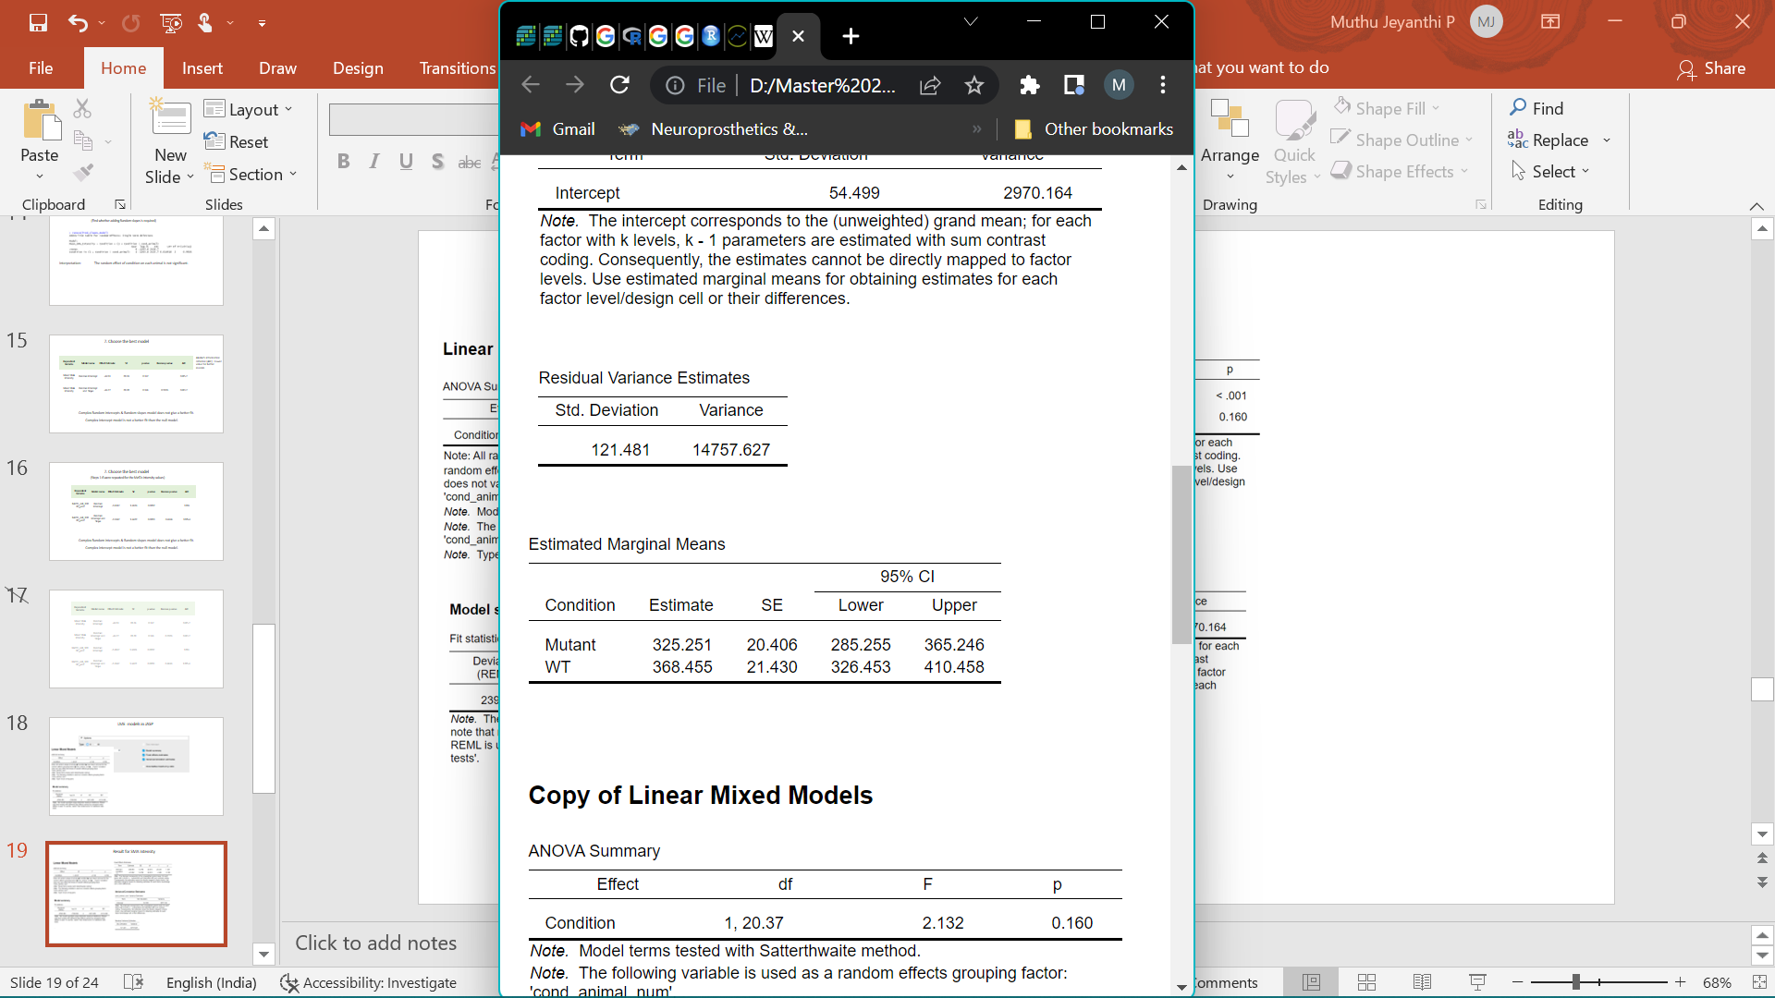
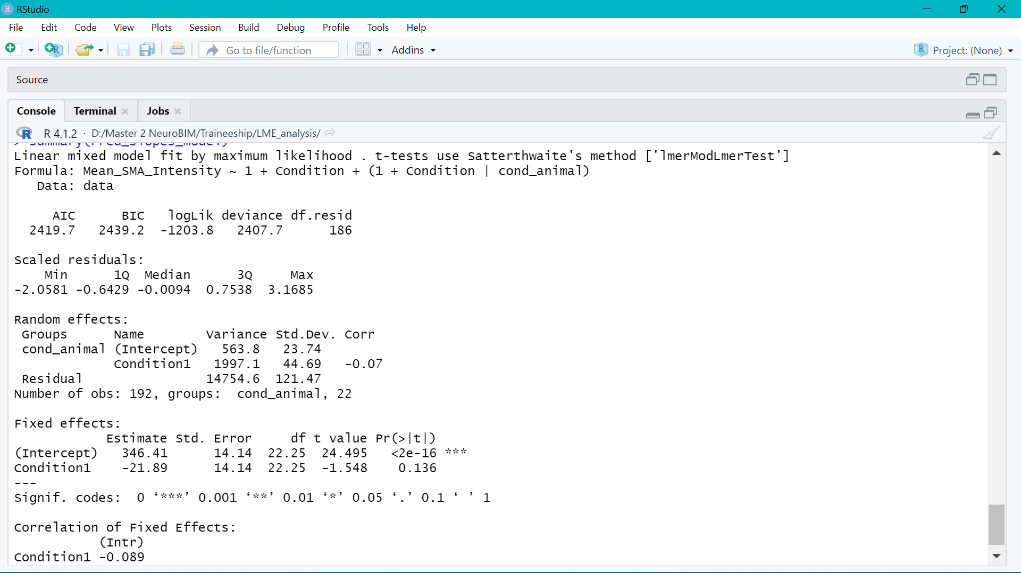
Result for SMA Intensity (Random Intercepts and Slopes model)
Sum contrast coding: Mutant: 1 WT : -1
Sum contrast coding: Mutant: 1 WT : -1
JASP
JASP
JASP
LME4
Similar results in R after sum contrast coding
Notes:
Usually intercept is the mean of the reference group. Effects are added or subtracted from that. This gives the marginal effect of one with respect to another.
0 → reference level ; 1 → second level
If the main effect is to be interpreted, use sum contrast coding. → Equivalent to mean centering
-1 → first level , 1 → second level , 0 → still the reference level. When we use it , the Intercept becomes the mean (grand mean across all cells ) without condition.
The main effects are traditionally interpreted as the difference between levels of a given factor, collapsed across all other factors
The estimate is how much the condition’s mean varies from the grand mean → main effect rather than marginal effect.
The mean intensity of mutant is 21.6 units less than the grand mean.

Slide 21
Result for SMA Intensity (Random Intercepts and Slopes model)
JASP
LME4
Notes:
Usually intercept is the mean of the reference group. Effects are added or subtracted from that. This gives the marginal effect of one with respect to another.
0 → reference level ; 1 → second level
If the main effect is to be interpreted, use sum contrast coding. → Equivalent to mean centering
-1 → first level , 1 → second level , 0 → still the reference level. When we use it , the Intercept becomes the mean (grand mean across all cells ) without condition.
The main effects are traditionally interpreted as the difference between levels of a given factor, collapsed across all other factors
The estimate is how much the condition’s mean varies from the grand mean → main effect rather than marginal effect.
The mean intensity of mutant is 21.6 units less than the grand mean.

Slide 22
Points to consider while using JASP
Sum contrast coding
Reports main effect of the condition rather effect of each level ( WT /Mutant)
Test Model Terms
Use ML to find the best model type. (Compare using LRT , Satterthwaite test is not available for ML method)
Use REML to fit that best model type for unbiased variance estimates.
Notes:
Usually intercept is the mean of the reference group. Effects are added or subtracted from that. This gives the marginal effect of one with respect to another.
0 → reference level ; 1 → second level
If the main effect is to be interpreted, use sum contrast coding. → Equivalent to mean centering
-1 → first level , 1 → second level , 0 → still the reference level. When we use it , the Intercept becomes the mean (grand mean across all cells ) without condition.
The main effects are traditionally interpreted as the difference between levels of a given factor, collapsed across all other factors
The estimate is how much the condition’s mean varies from the grand mean → main effect rather than marginal effect.
The mean intensity of mutant is 21.6 units less than the grand mean.

Slide 23
Thank You!

Slide 24
Dependent Variable | Model name | Effect Estimate | SE | p-value | Ranova p-value For Condition in Random Effect | AIC
Mean SMA Intensity | Random Intercept | -43.51 | 28.24 | 0.137 |  | 2415.7
Mean SMA Intensity | Random Intercept and Slope | -43.77 | 28.28 | 0.136 | 0.9926 | 2419.7
Mef2c_cell_10000_µm2 | Random Intercept | -2.4167 | 1.3603 | 0.0892 |  | 1283
Mef2c_cell_10000_µm2 | Random Intercept and Slope | -2.3947 | 1.3422 | 0.0899 | 0.4636 | 1285.4

Slide 25
Test Method | When to use
Satterwhaite | ML or REML models
Kenward Roger | REML models
Likelihood Ratio test | Large sample size ML fits
Parametric bootstrap | No assumptions about dof; Repeated sampling to obtain p-values from LRT Computationally intensive but works for all sample sizes

Slide 26
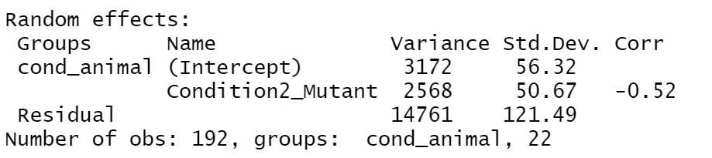
6. Check significance of slope variance between animals
Find whether adding Random slopes is required
Base model
Random Intercept & Slopes model with Predictor
Explained Variance
14738 - 14761
Level 2 (Cond_animal)
3294 - 3172
Level 1
(Residual)
=
=
14738
3294
=
-0.0016
=
0.098

Slide 27
Points to consider while using JASP
Input Terms:
Data table,
REML or ML
Dummy coding or sum contrast coding
Fixed effect
Random Effect
Result :
Effect estimate and p value for the data.
LRT : Require Large sample size. High Type 1 error for small samples (< 40 – 50)
ML and satterwaite for small sample size
Notes:
Usually intercept is the mean of the reference group. Effects are added or subtracted from that. This gives the marginal effect of one with respect to another.
0 → reference level ; 1 → second level
If the main effect is to be interpreted, use sum contrast coding. → Equivalent to mean centering
-1 → first level , 1 → second level , 0 → still the reference level. When we use it , the Intercept becomes the mean (grand mean across all cells ) without condition.
The main effects are traditionally interpreted as the difference between levels of a given factor, collapsed across all other factors
The estimate is how much the condition’s mean varies from the grand mean → main effect rather than marginal effect.
The mean intensity of mutant is 21.6 units less than the grand mean.

Slide 28
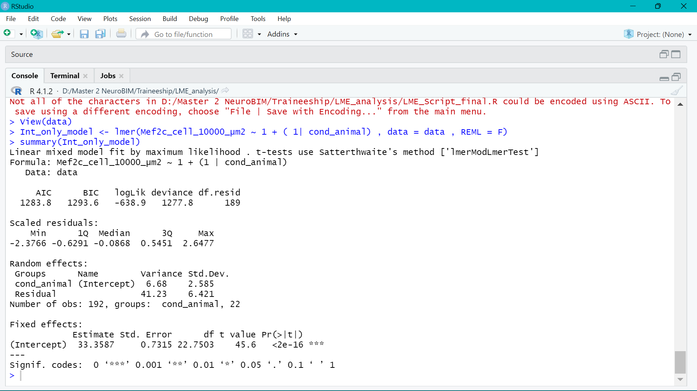
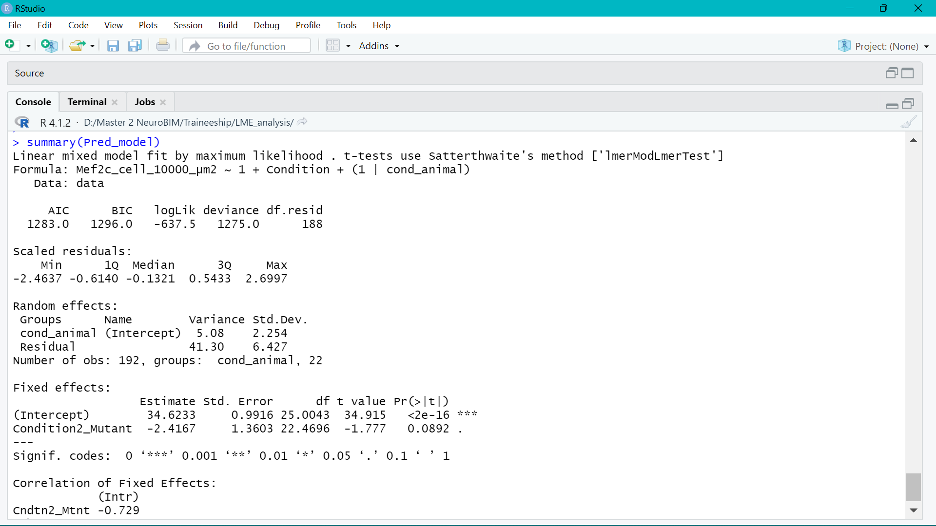
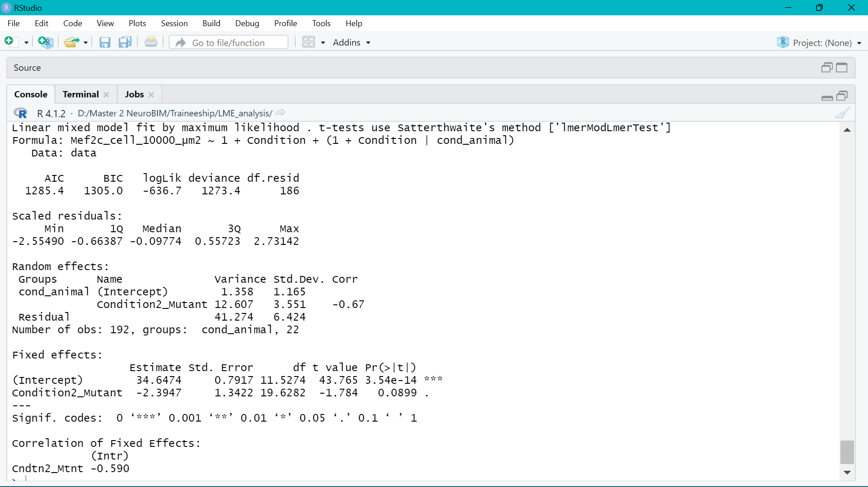
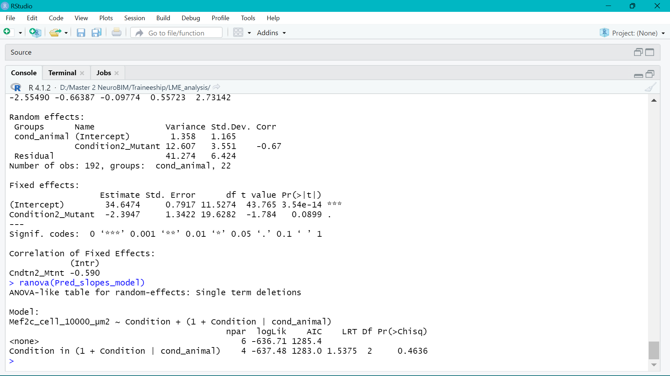
Null model
Random Intercept model
Random Intercept & Slopes model
Anova

Slide 29




Animal j
$$β0$$
Average SMA Intensity
$$β1$$
$$β0j$$
$$β1$$
Deviation of intercept
WT
Mutant

